Slide 1

REPRESENTED BY
Name : Nikunj Kumar
Branch : Computer Science and Engineering
Registration No. : 24105141052

Slide 2
Introduction
A calculator is a software application used to perform mathematical calculations.
This project is developed using Java Swing to create a graphical user interface that allows users to perform different arithmetic operations easily.

Slide 3
Objectives
Develop a GUI calculator using Java
Perform basic arithmetic operations
Understand event handling in Java Swing
Implement additional features like currency conversion

Slide 4
Technologies Used
Java Programming Language
Java Swing (GUI Library)
AWT Event Handling
Object Oriented Programming (OOP)

Slide 5
Features of the Calculator
Addition (+)
Subtraction (−)
Multiplication (×)
Division (÷)
Percentage (%)
Square, Square Root
Reciprocal (1/x)

Slide 6
Program Logic
double calculate(double a, double b, String op) {
switch(op) {
case "+": return a + b;
case "-": return a - b;
case "*": return a * b;
case "/": return (b != 0) ? a / b : 0;
double square(double x){ return x * x; }
double sqrt(double x){ return Math.sqrt(x); }
double percentage(double x){ return x / 100; }
double reciprocal(double x){ return 1 / x; }
}
return 0;
}

Slide 7
Working of the Program
Start
↓
Enter Number
↓
Select Operator
↓
Enter Second Number
↓
Press "="
↓
Perform Calculation
↓
Display Result
↓
End

Slide 8
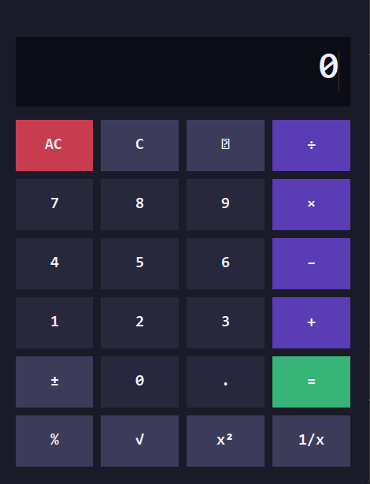
Calculator Interface (GUI)

Slide 9
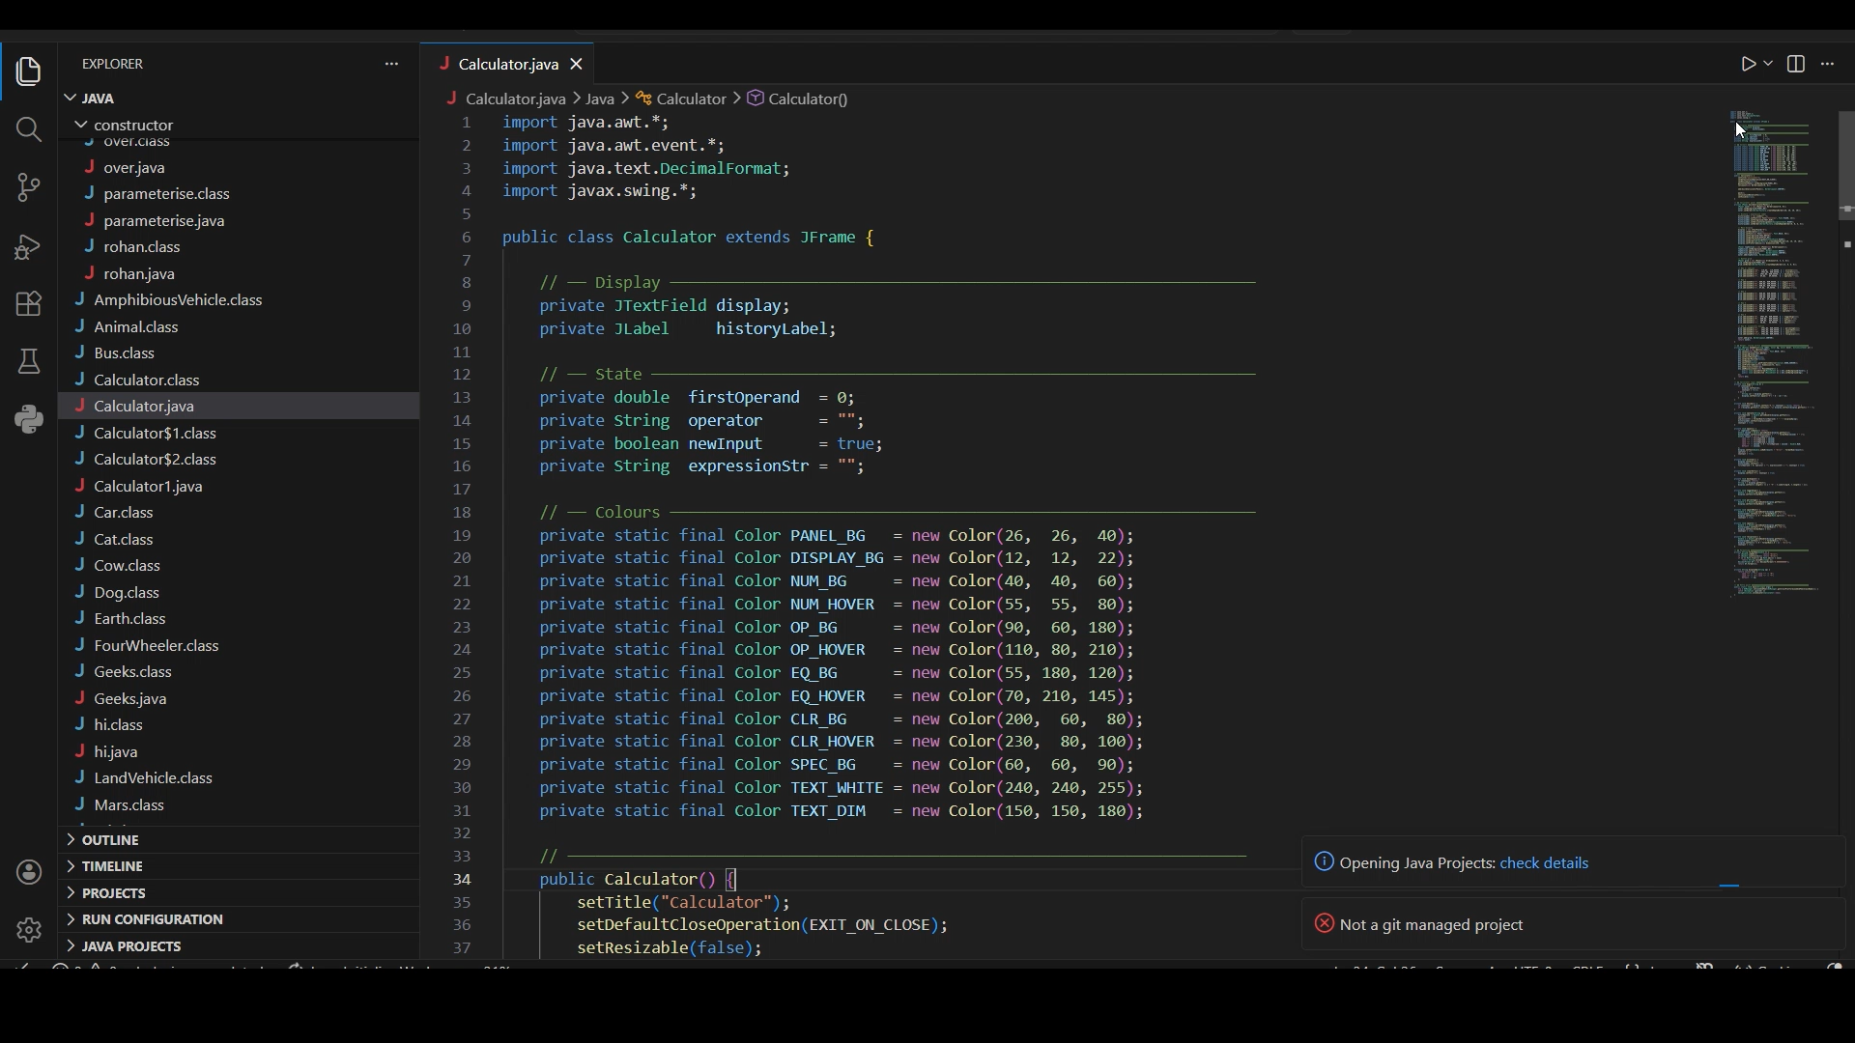
Output

Slide 10
Advantages
Easy to use interface
Fast calculations
Multiple operations available

Slide 11
Conclusion
The Java Calculator project demonstrates the use of Java Swing for GUI development and event handling to perform mathematical operations efficiently.

